Slide 1
AJAX

Slide 2
AJAX – Whatzit?
Asynchronous (content loading)‏
Javascript (logic & control)‏
And
XML (request handling)‏

Slide 3
AJAX - Really?
Set of cross-platform conventions and techniques to load data browser-side, without interfering with the display and behaviour of the existing page
Relies on Javascript & the DOM, assumes XHTML & CSS used
XMLHttpRequest object in browser

Slide 4
AJAX – Whyzit?
Reload content pieces parts of an HTML page) without complete page reload

Slide 5
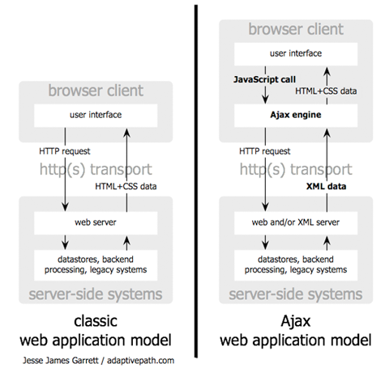
HTTP Transport with Ajax

Slide 6
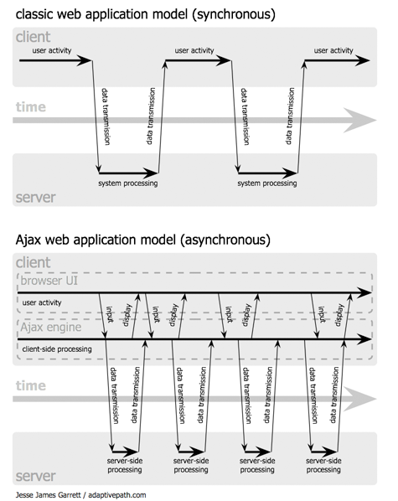
Request
Processing

Slide 7
XmlHttpRequest
Browser object to retrieve content from server page was dished from
Need a new such object for each request
Uses a callback mechanism when the HTTP request state changes

Slide 8
XmlHttpRequest Methods
abort()‏
  Aborts current request
getAllResponseHeaders()‏
  Returns set of HTTP headers as string
getResponseHeader( headerName )‏
  Return specified HTTP header value
open( method, URL, [async, [userName, [password]]] )‏
  Specifies the method, URL & other request attributes
send( content )‏
  Send the request
setRequestHeader( label, value )‏
  Set an HTTP request header

Slide 9
XmlHttpRequest Properteis
onreadystatechange -> callback function
readystate
  0..4 (uninitialized, open, send, receiving, done)‏
responseText = response as string
responseXml = response as XML fragment
responseBody = response as binary-encoded string
status = HTTP response code
statusText = status as string

Slide 10
Browser Handling
if (window.XMLHttpRequest) // Existing class
{
xhr = new XMLHttpRequest(); // Firefox, Safari, ...
}
else
if (window.ActiveXObject) // ActiveX version
{
xhr = new ActiveXObject("Microsoft.XMLHTTP"); // I.E.
}
xhr.onreadystatechange = function() { // instructions to process the response };
xhr.open('GET', 'http://www.xul.fr/somefile.xml', true);
xhr.send(null); // for POST only

Slide 11
Reponse Handling
xhr.onreadystatechange = function()‏
{
if(xhr.readyState == 4)‏
{
if(xhr.status == 200)
document.ajax.dyn="Received:" + xhr.responseText;
else
document.ajax.dyn="Error code " + xhr.status;
}
};
document.getElementById("zone").innerHTML = "Received:" + xhr.responseText;

Slide 12
Ajax Advantages
Bandwidth friendly
Better separation of data & presentation
Considered a “Rich Internet Application” (RIA)‏
a.k.a. Part of Web 2.0 0 0 0

Slide 13
Ajax Issues
Browser integration
  Back-button
  Bookmark ease
  Javascript enabled
Reponse time concerns
Reliance on Javascript & DOM
Web analytics

Slide 14
Ajax Libraries
Dojo
Mochikit (Google)‏
Prototype
YUI
jMaki
JavaFX
extJS

Slide 15
Dojo AJAX Example
<script type="text/javascript">
function hello() { // ➁
dojo.xhrGet( { // ➂
// The following URL must match that used to test the server.
url: "http://server/ajax.txt",
handleAs: "text",
timeout: 5000, // Time in milliseconds
// The LOAD function will be called on a successful response.
load: function(response, ioArgs) { // ➃
dojo.byId("cargo").innerHTML = response; // ➄
return response; // ➅
},
// The ERROR function will be called in an error case.
error: function(response, ioArgs) { // ➃
console.error("HTTP status code: ", ioArgs.xhr.status); // ➆
return response; // ➅
}
});
}
</script>

Slide 16
DOJO AJAX in Practice
var kw = {
url: "myprogram.php",
load: function(data){
dojo.byId('myBox').value = data;
},
error: function(data){
console.debug("An error occurred: ", data);
},
timeout: 2000,
form: "myForm"
};
dojo.xhrGet(kw);

